Slide 1
Love My Credit Union Campaign
What’s New in 2016

Slide 2
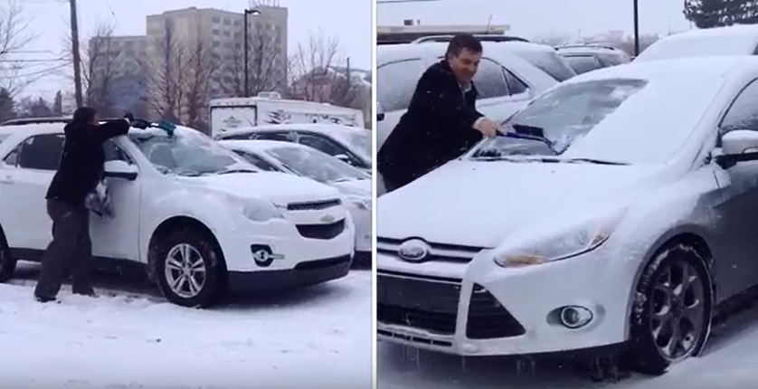
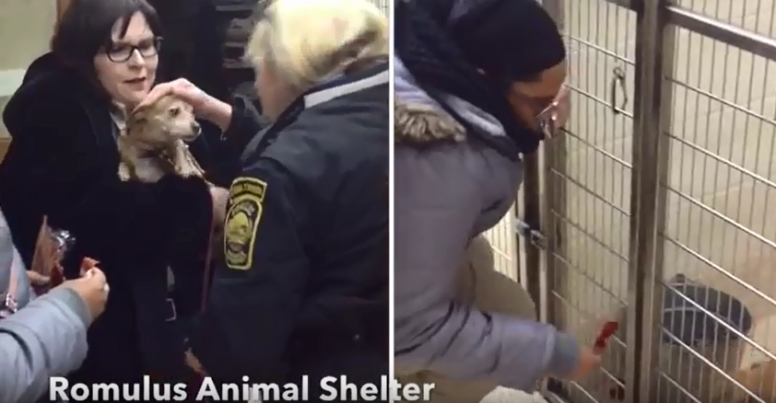
How it Started
The campaign was inspired by Public Service Credit Union in Michigan who created a video showcasing their credit union employees demonstrating random acts of kindness from paying for people’s gas to handing out donuts.
Seeing their video sparked the idea for a national video campaign to showcase the good work credit unions do every day for their community and award thousands of dollars to charities.

Slide 3
How it Started
CU Solutions Group and its member rewards program, Love My Credit Union Rewards, teamed up with CUNA to launch “Share the Love”
The first year of the campaign was launched at the ACUC in July 2015.
Credit unions nationwide were called upon to create a short video showing how they give back in their communities. Videos were posted online and members of the public were able to view and vote for their favorites. Each month, the videos garnering the most votes were awarded with donations made to the winning credit unions’ chosen charities

Slide 4
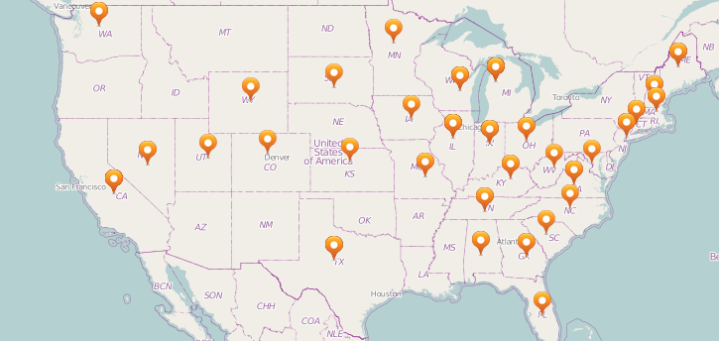
2015 Highlights
132 credit union videos were submitted across 35 states
426,416 votes cast for Share the Love videos
$105,000 donated to nine charities
$15,000 awarded in consumer prizes
4
1
4
1
1
5
46
2
1
2
1
2
2
3
1
1
1
7
5
1
2
1
2
2
3
12
3
1
1
2
2
2
5
2
1

Slide 5
What’s New in 2016

Slide 6
New Campaign Name
Resonates with our target audience
Communicates the credit union difference
Differentiates us from other campaigns

Slide 7
Objectives and Goals
Develop a campaign for credit unions and credit union support organizations to create a video of how they Share the Love
Promote the credit union difference to a national audience through videos that reflect credit unions’ and credit union support organizations’ commitments to their communities
Drive consumer awareness to charities, credit unions, and credit union support organizations
Award several more charities with donations
Inspire random acts of kindness
Goals:
500 credit union videos
30 cu support organization videos
1 million votes

Slide 8
More Prizes and Ways Win
Up to $122,500 will be awarded to charity:
8 credit union monthly prizes of $5,000
1 credit union grand-prize of $15,000
50 states could win a $1,000 donation for the CU in their state with most overall votes
1 CU Support Organization grand-prize of $15,000
5 consumer winners will be randomly selected and each win $1,000: $500 donated to their charity of choice and $500 to keep
NEW: 4 asset categories
NEW: State-level prizes
NEW: Category
NEW: Consumer prizes to the charity of their choice

Slide 9
Campaign Timeline
National Launch: ACUC June 27
Video Upload Opens: July 1
Consumer Campaign Launch: September
Voting Begins: October 1
Month 1 CU winners: October 31
Month 2 CU winners: November 30
Month 3 CU, CU Support Org, and Consumer winners: December 16
Voting closes: December 16 at 11:59 pm EST

Slide 10
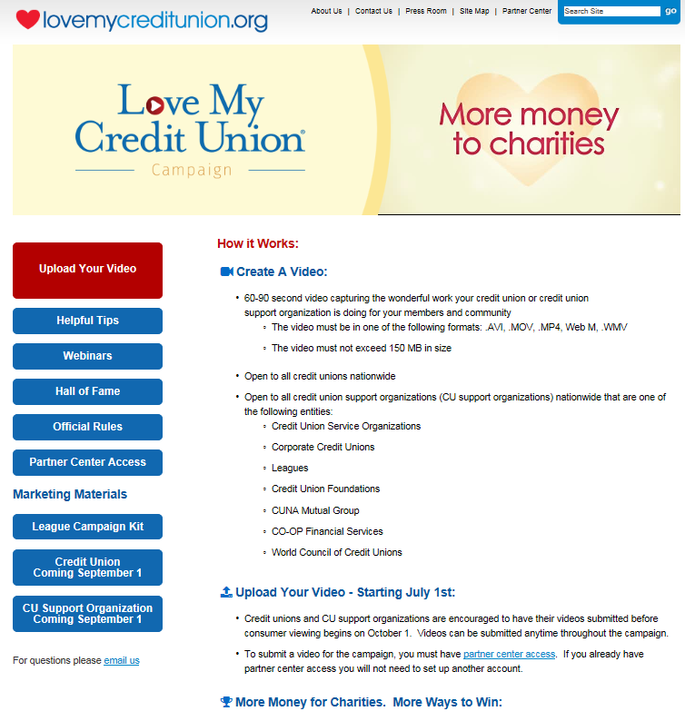
Campaign Site
Getting started is easy!
Visit LoveMyCUCampaign.org for campaign details, official rules, webinars, marketing materials, and to upload your video.

Slide 11
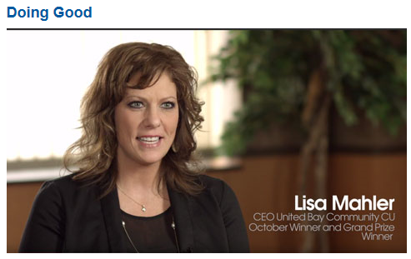
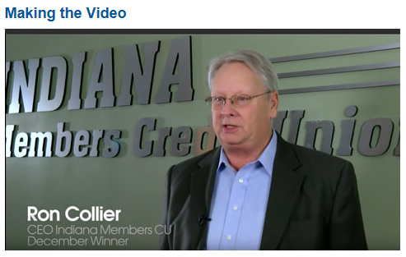
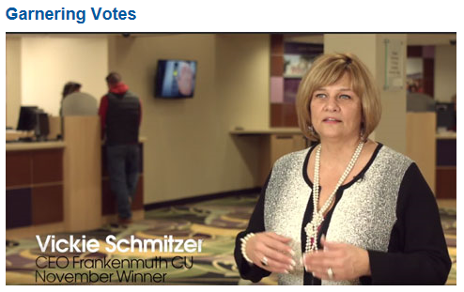
Helpful Tips
Check out best practice videos from last year’s winners:
Doing Good
Making the Video
Garnering Votes
“It’s Easy” – 2 minute video on tips to film a video
Video best practice tips and resources PDF

Slide 12
Create a Video
60-90 second video capturing the wonderful work your credit union or credit union support organization is doing for your members and community
Want to learn how easy it is to create a video? Register to attend one of our live “Simple Ways to Make a Video” webinars:
Tuesday, July 19 at 3pm EST
Wednesday, July 27 at 3pm EST

Slide 13
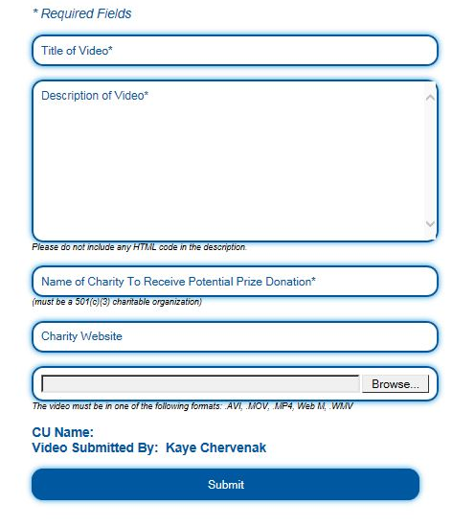
Submit a Video
Open to all credit unions nationwide
Open to all cu support organizations:
Credit union service organizations
Leagues
Corporate credit unions
CU foundations
CO-OP Financial Services, CUNA Mutual Group, WOCCU
Only one video entry per credit union and per cu support organization
Starting July 1, 2016 video upload opened at LoveMyCUCampaign.org
Videos can be submitted any time during the campaign

Slide 14
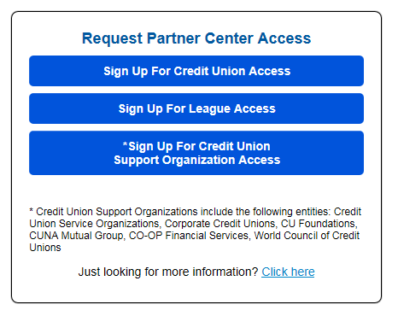
Partner Center Account
To submit a video on behalf of a credit union or cu support organization, a representative must have or request a Partner Center account
To request a Partner Center account, click on the organization type you are representing and complete the required fields. Account access is set-up within 1 business day.

Slide 15
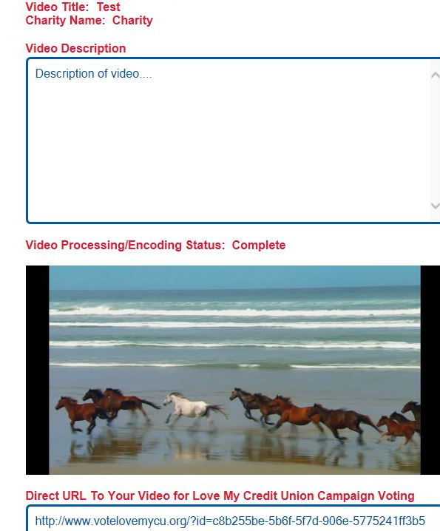
Confirmation & Direct URL
Upon successful video submission, you will receive a confirmation email and direct URL to your video for digital marketing.
Free marketing materials will be available for credit unions and cu support organizations on September 1st
You can also visit the video upload portal to access your direct URL and verify video submission details

Slide 16
Voting
Videos submitted will be displayed on VoteLoveMyCU.org starting October 1, 2016. Follow the links and instructions to complete and submit the short registration form.
Consumers can cast one vote per day for a credit union video and one vote per day for a cu support organization video, earning up to two (2) entries per day into the consumer sweepstakes
Voting ends on December 16, 2016 at 11:59 pm ET

Slide 17
Prizes
$40K - 8 Credit Unions @ $5,000
October 31: 4 credit union winners will be selected to receive a $5,000 donation to their charity of choice, top votes in each category based on asset size
November 30: 4 credit union winners will be selected to receive a $5,000 donation to their charity of choice, top votes in each category based on asset size
Credit Union Asset Categories:
Based on the Credit Union’s asset size, it will fall into one (1) of the following four (4) Credit Union categories:
Asset Size | Credit Union Category
Less than $100 million | 1
$100 – $249 million | 2
$250 – $499 million | 3
$500 million or more | 4

Slide 18
Prizes
$15K - 1 Credit Union Grand-Prize @ $15,000
The credit union grand-prize winner will be decided based on the most overall votes as of December 16th at 11:59 pm ET. Previous credit union monthly winners are eligible to win
$50K- 50 states could win a $1,000 donation for the Credit Union in their state that received the most overall votes
After the conclusion of the Voting Phase, December 16, the Credit Union from each state with the largest number of cumulative votes received will win $1,000 donation, if and only if at least five (5) videos (or at least three (3) videos for the states of Alaska, Nevada, New Hampshire, Delaware, Rhode Island, Vermont and Wyoming) were submitted for that state.

Slide 19
Prizes
$15K - 1 CU Support Organization grand-prize @ $15,000
One (1) Credit Union Support Organization will receive a $15,000 donation to their charity of choice based on the most votes in the CU Support Organization category as of December 16
$5K - 5 consumer winners
Five (5) sweepstakes prizes will be awarded to consumers who cast a vote(s) during the campaign. The winners will be randomly selected and each will receive a $500 Visa gift card and a $500 donation to their charity of choice
Individuals who enter the Sweepstakes must be at least thirteen (13) years old at the time of entry
By the end of the campaign, up to $122,500
will be awarded to charities!

Slide 20
Questions?
Please contact: clientsupport@cusolutionsgroup.com

